Slide 1



COMPUTER SCIENCE — CAPSTONE PROJECT A
Semester Project List
Industry-mentored and research-track capstone projects for Project A, September 2026
Prepared by the Academic Experience Office · Department of Computer Science
COS40005 · September 2026

Slide 2
WHAT'S INSIDE
Two paths, one semester
PATH 1
PATH 2
Industry Projects
Research Projects
Three partner organisations brief and mentor student teams on real business problems.
Five majors, twenty-five faculty-authored topics, under two academic supervisors.
AWS FCAJ — VIB and Katalon assignments; Cloud Kinetics
Huawei CBG — AI FitWear platform
ISC2 Vietnam Chapter — five AI-security R&D topics
Software, Data Science, AI, AIoT, Cybersecurity — 5 topics each
Supervisors: Dr. Dang Tran Khanh & Dr. Nguyen Xuan Sam
Shared Distinction / High Distinction evidence guidance
Project A · September 2026
2 / 19

Slide 3
PROJECT A — COS40005
How the unit runs
Assessment & timeline
Delivery model
Assessment | Weight | Due
Worklog | 10% | Weekly, weeks 1–12
Research Report | 10% | End of week 3
Team & Project Plan | 15% | End of week 3
Sprint Reports | 60% | Weeks 6, 9 and 12
Video Presentation | 5% | End of week 13
Every team has a staff facilitator who meets weekly across all 12 teaching weeks
Hurdle requirement: an overall mark of 50% or more, and the project completed to an acceptable standard against the rubric — otherwise the unit mark is capped at 45%
Assessments are completed without genAI assistance, per unit policy
Project A carries into Project B (COS40006): quality assurance, handover and the final pitch
Project A · September 2026
3 / 19

Slide 4



PART ONE
Industry Projects
Three partner organisations brief and mentor Project A teams this semester.

Slide 5




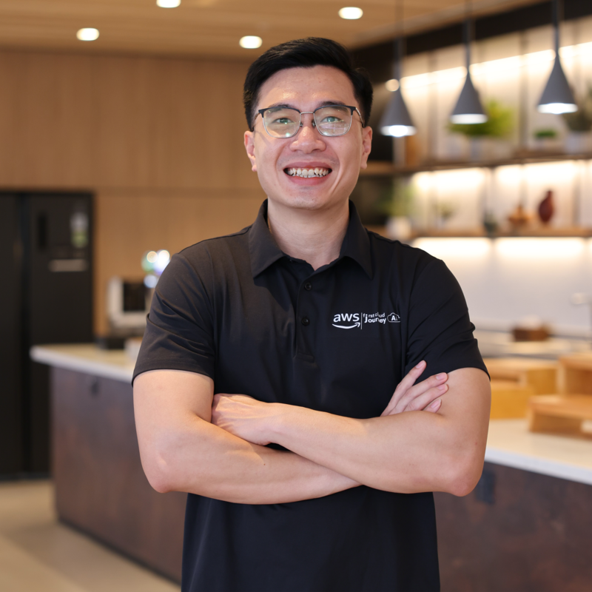
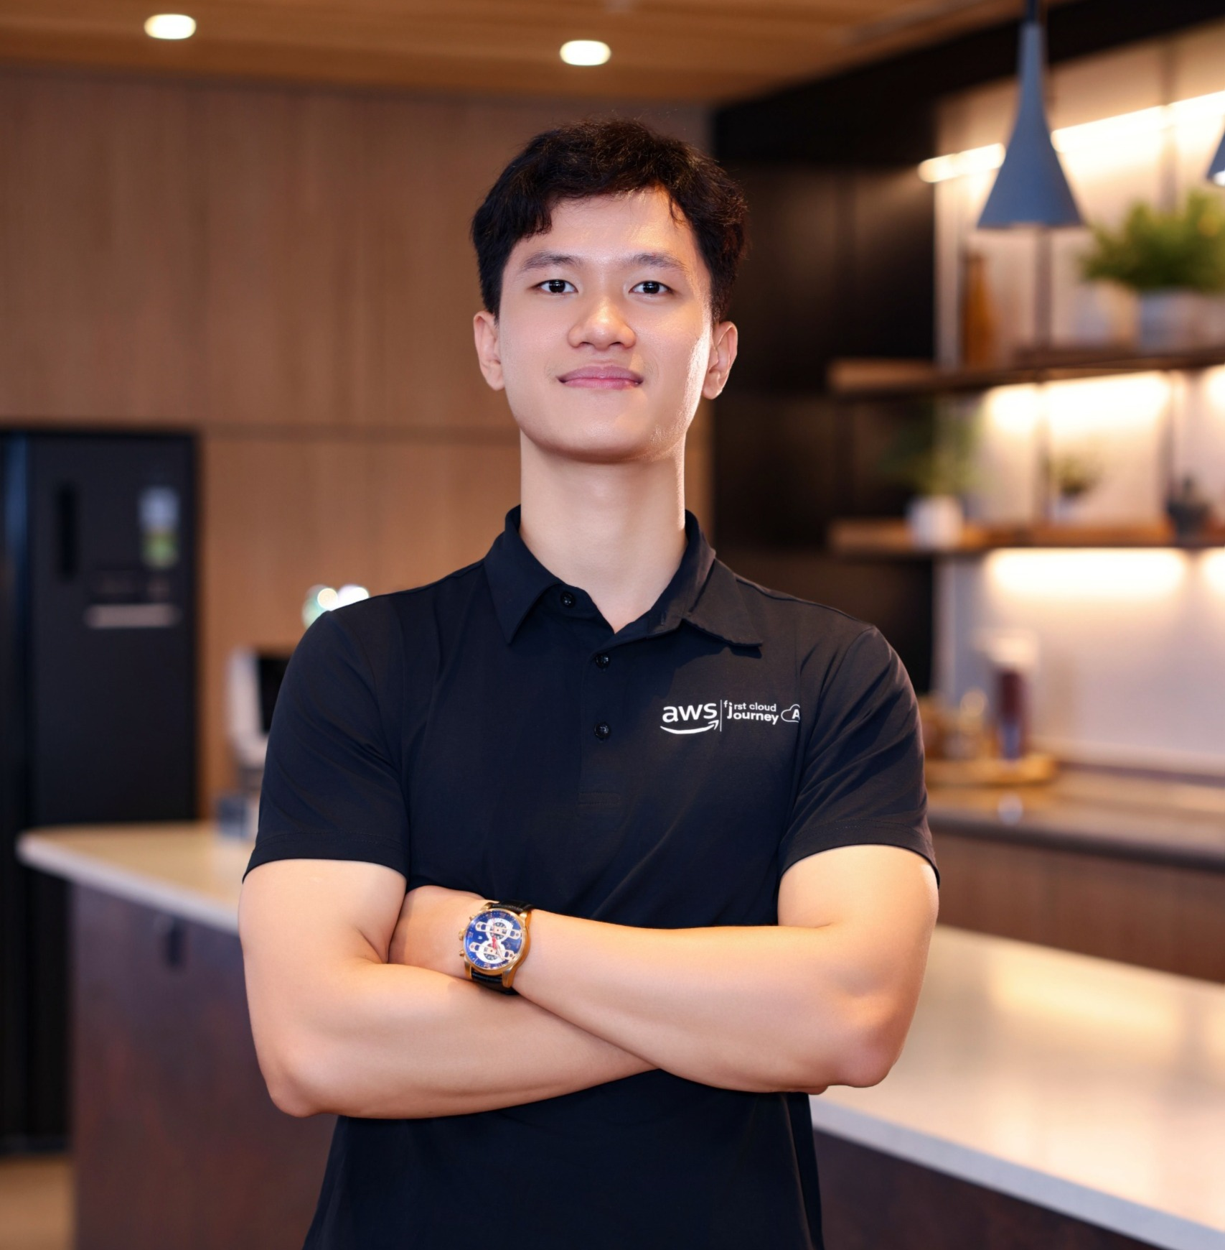
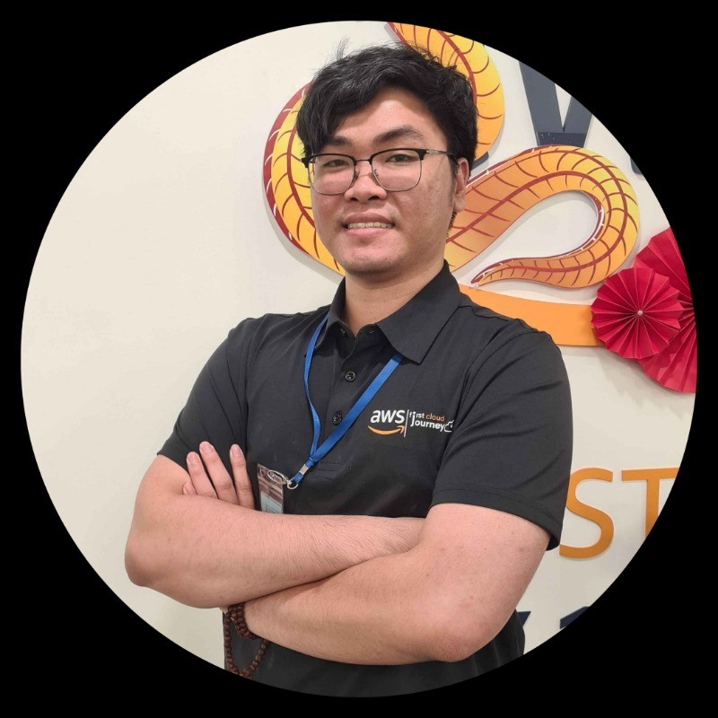

INDUSTRY PROJECTS — AWS FCAJ
AWS First Cloud AI Journey
A partnership between Swinburne Vietnam and the AWS FCAJ program (program lead: Mr. Lữ Thiện), bringing AWS-hosted engineering problems to Project A teams through partner organisations.
Thuận Phát
Tran Huu Nghia
Lê Minh Nghĩa
Aiden Dinh
Khang Nguyen
Cloud Solution Architect, VIB
Agentic AI Solutions Architect, VIB
Cloud Engineer, ITRVN
Operations Engineer, Katalon
Solutions Architect, Cloud Kinetics
Industry Projects · AWS FCAJ
5 / 19

Slide 6
AWS FCAJ — VIB ASSIGNMENTS
VIB assignments
Mentor: Thuận Phát — Cloud Solution Architect, VIB
VIB 1: Internal Assistant for Enterprise Knowledge
VIB 2: Consistent AI-Generated Output for Internal Documents
VIB 3: Coordinated Slack AI Agents Across Departments
A Slack-integrated chatbot that answers employee questions from scattered internal sources (Confluence, document sites, forums), with an ingestion pipeline and access control.
A mechanism that keeps AI-drafted reports and BRDs compliant with internal rules, policies and templates, reducing rework passed between teams.
Domain-specific Slack agents (e.g. Developer, CloudOps) that can request information from one another without exposing data outside their access scope.
Industry Projects · AWS FCAJ
6 / 19

Slide 7
AWS FCAJ — KATALON ASSIGNMENTS
Katalon assignments
Mentor: Lê Minh Nghĩa — Cloud Engineer, ITRVN
Medium
Hard
Easy
Katalon 1: Customer Support Email Campaign Platform
Katalon 2: Amazon EKS Windows Containers for Test Automation
Katalon 3: Secure CI/CD Pipeline Deployment to Amazon EC2
An email campaign platform on Amazon Connect and Amazon SES, with dynamic templates, segmentation, scheduling and resilient bulk sending.
Windows workloads on Amazon EKS with per-user containers created and torn down on demand in under a minute, with strict tenant isolation.
A CI/CD pipeline that builds, tests and deploys to EC2 on every commit, with zero/minimal downtime, automatic rollback and no public SSH access.
Industry Projects · AWS FCAJ
7 / 19

Slide 8
AWS FCAJ — CLOUD KINETICS
Project briefs pending
STATUS: TO BE CONFIRMED
Cloud Kinetics has not yet submitted project briefs for this semester. Topics and scope are still to be confirmed with AWS FCAJ before teams can be briefed.
Khang Nguyen
Solutions Architect, Cloud Kinetics
Industry Projects · AWS FCAJ
8 / 19

Slide 9

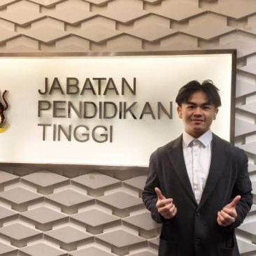
INDUSTRY PROJECTS — HUAWEI CBG
Huawei Consumer Business Group
A partnership between Swinburne Vietnam and Huawei's Consumer Business Group, bringing the AI FitWear brief to Project A teams through Huawei's Vietnam and Cloud APAC teams.
Linh Ngô
Khyhoong
BD Manager, Huawei Vietnam
Software Technical Support, Huawei Cloud APAC
Project owner & mentor
Project owner & mentor
Industry Projects · Huawei CBG
9 / 19

Slide 10
INDUSTRY PROJECTS — HUAWEI CBG
AI FitWear: Smart Fitness & Watch Ecosystem
Addressing manual fitness logging and the lack of real-time form guidance for beginner gym-goers, through dual-device AI automation.
Pain points
Objectives
Manual food tracking is tedious, causing drop-off
Beginners get no in-workout guidance without a personal trainer
Mobile apps and smartwatches rarely sync in real time
Multi-modal meal AI: instant photo-based calorie and macro analysis
Wrist-based assistant: automated rep detection and haptic rest control
Autonomous closed loop between mobile (central brain) and watch (sensor agent)
Industry Projects · Huawei CBG
10 / 19

Slide 11
INDUSTRY PROJECTS — HUAWEI CBG
Deliverables, stack and mentors
Expected deliverables
Mentors
Mobile app (iOS/Android): AI food recognition, macro breakdown, automated workout planner
Watch app (HarmonyOS, ArkTS): live dashboard, IMU rep counting, haptic rest alerts
Bi-directional sync engine over BLE / WebSockets
Documentation and a validation report on recognition accuracy and motion precision
Linh Ngô
Khyhoong
BD Manager, Huawei Vietnam
Software Technical Support, Huawei Cloud APAC
Stack: ArkTS + Huawei DevEco Studio for the watch app; mobile framework at the team's discretion; vision via GPT-4o Vision / Gemini Flash or a fine-tuned YOLO/MobileNet model.
Industry Projects · Huawei CBG
11 / 19

Slide 12
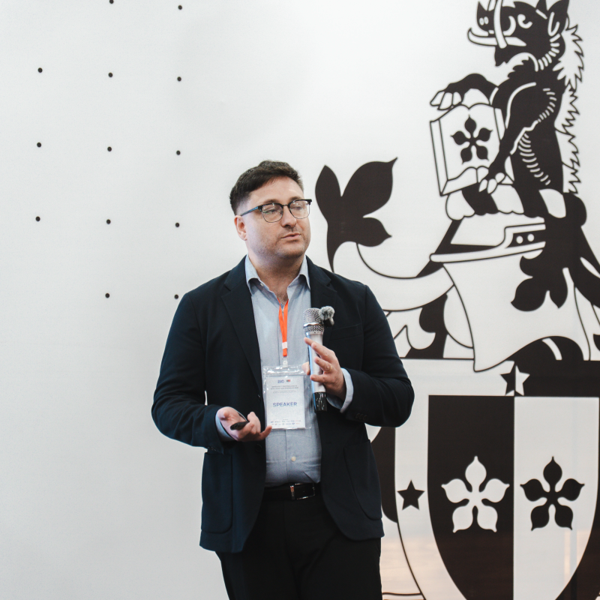
INDUSTRY PROJECTS — ISC2 VIETNAM CHAPTER
ISC2 Vietnam Chapter
A partnership between Swinburne Vietnam and the ISC2 Vietnam Chapter, bringing five AI-security R&D topics to Project A teams under a single mentor.
Robert Leyba
VP, ISC2 Vietnam Chapter
Mentor for all 5 topics
Industry Projects · ISC2 Vietnam Chapter
12 / 19

Slide 13
INDUSTRY PROJECTS — ISC2 VIETNAM CHAPTER
AI & Cybersecurity R&D Portfolio
Five proposed research directions spanning security operations, LLM application security, agentic AI, malware analysis and AI governance.
# | Topic | Research focus
1 | Human-AI Collaboration for Cybersecurity Incident Investigation | Whether AI improves analyst speed and accuracy without unacceptable error or over-reliance.
2 | Security Testing and Evaluation of LLM-Enabled Applications | A repeatable security-evaluation framework for prompt injection, data exposure and unsafe output.
3 | Security Validation for Agentic AI and Tool-Using Systems | How permissions, tool use and autonomy can create or amplify security risk.
4 | Human-AI Malware Triage and Threat Analysis | Whether AI can speed up malware triage while preserving evidence quality and explainability.
5 | From AI Policy to Measurable Security Controls | Translating AI governance requirements into testable controls and assurance metrics.
Each topic follows the same two-semester R&D lifecycle — research, prototype, experimentation, evaluation, final delivery — spanning Project A and Project B.
VP, ISC2 Vietnam Chapter
Robert Leyba
Industry Projects · ISC2 Vietnam Chapter
13 / 19
Mentor for all 5 topics

Slide 14
PART TWO
Research Projects
Five majors, twenty-five faculty-authored topics, under two academic supervisors.

Slide 15
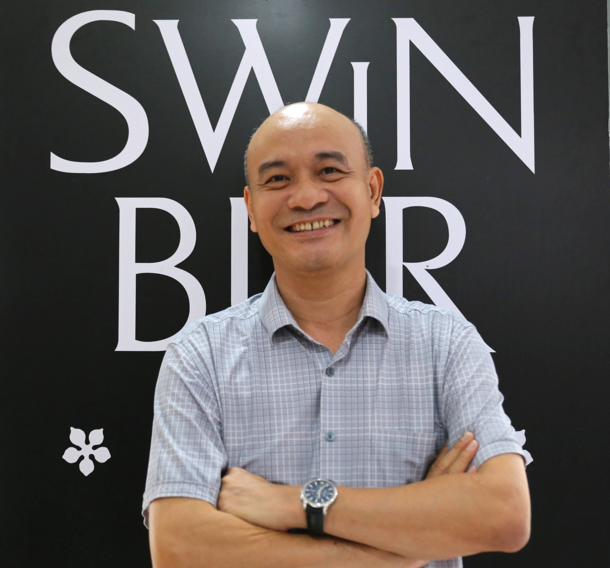
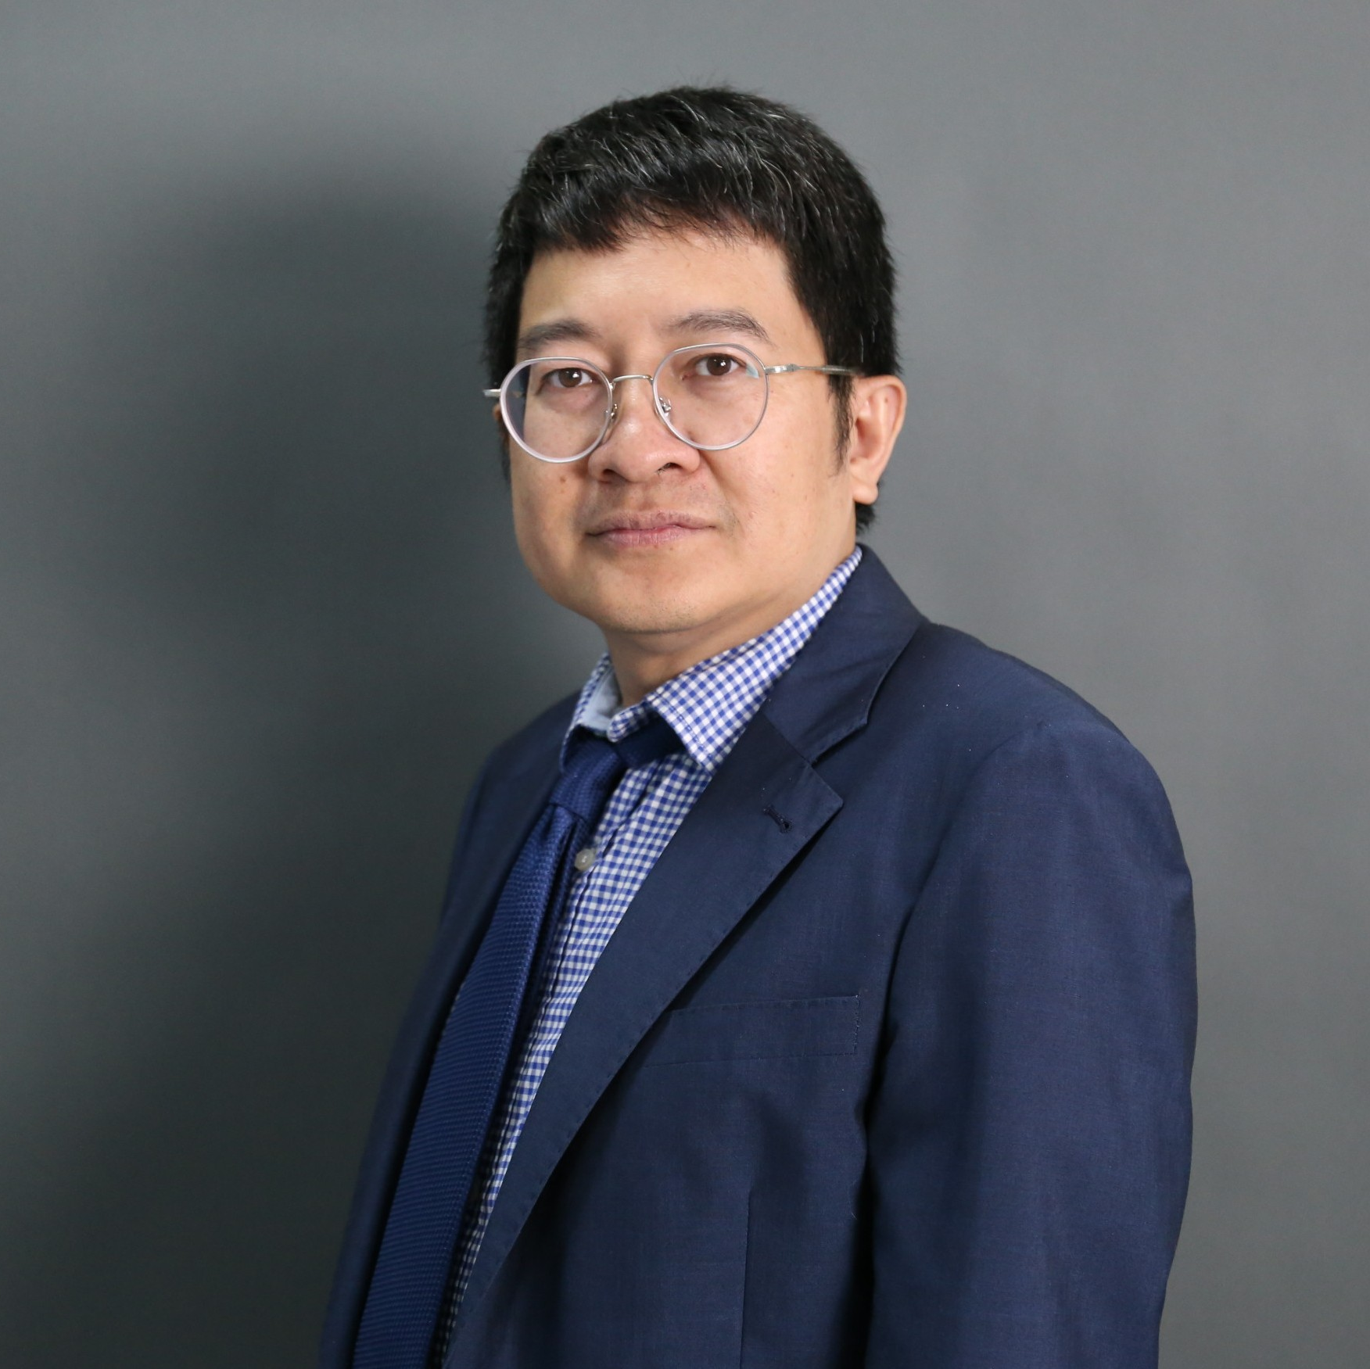
RESEARCH PROJECTS
Five majors, one shared model
Proposed guidance; final grades follow the approved unit rubric. No automatic grade entitlement.
Software
Data Science
AI
AIoT
Cybersecurity
5 topics
5 topics
5 topics
5 topics
5 topics
D/HD EVIDENCE AREAS
Meaningful applied AI · international workshop or conference participation · hackathon, competition or certification
Dr. Dang Tran Khanh
Dr. Nguyen Xuan Sam
Academic Supervisor & Lecturer, Project A
Academic Supervisor & Lecturer, Project A
Research Projects · Project A
15 / 19

Slide 16
RESEARCH PROJECTS
Software & Data Science topics
Software
Data Science
SW01 — Industry Project and Capstone Management Platform
DS01 — Retail Demand Forecasting and Inventory Planning
Portal for proposals, teams, milestones and feedback.
Forecasting pipeline and replenishment dashboard.
SW02 — Smart Appointment and Queue Management System
DS02 — Student Engagement and Academic Support Analytics
Booking app with queue tracking and notifications.
Dashboard flagging engagement and support needs.
SW03 — Internship and Employer Engagement Platform
DS03 — Urban Air Quality Analysis and Forecasting
Placements, attendance and employer feedback.
Spatial analysis and forecasting of air quality.
SW04 — Inventory and Order Management for Small Businesses
DS04 — Customer Segmentation and Retention Analytics
Stock, orders and reporting for a small business.
Segmentation, churn model and retention dashboard.
SW05 — Automated Software Testing and Code Review Assistant
DS05 — Service Demand and Resource Allocation Simulator
Flags risky code changes and suggests tests.
Demand forecasts feeding a staffing simulator.
Research Projects · Project A
16 / 19

Slide 17
RESEARCH PROJECTS
AI & AIoT topics
AI
AIoT
AI01 — University Document Question-Answering Assistant
AIOT01 — Smart Classroom Air Quality and Occupancy Monitoring
RAG assistant with citations over university documents.
Sensors, occupancy estimation and ventilation alerts.
AI02 — Vietnamese Sign-Language Recognition for a Defined Vocabulary
AIOT02 — Intelligent Irrigation for Small-Scale Agriculture
Soil sensing driving an irrigation controller.
Camera-based recognition of a sign vocabulary.
AIOT03 — Machine Condition Monitoring and Fault Detection
AI03 — Visual Product Defect Detection
Vibration sensing for edge fault detection.
Inspection app detecting visible product defects.
AIOT04 — Edge-Based Waste Classification Prototype
AI04 — Adaptive Learning and Practice Recommendation System
Camera-based sorting of waste categories.
Adaptive practice recommendations from performance.
AIOT05 — Cold-Chain Monitoring and Temperature Excursion Prediction
AI05 — Compact Text Classification for CPU Deployment
Predicts cold-chain temperature excursions.
Compressed text classifier for CPU inference.
Research Projects · Project A
17 / 19

Slide 18
RESEARCH PROJECTS
Cybersecurity topics
Cybersecurity
CYB01 — SMS and Email Phishing Detection Assistant
D/HD EVIDENCE, RECAP
Screens SMS/email for phishing, with explanations.
Meaningful applied AI: integrate AI into a core use case and justify it against a baseline
International workshop or conference: poster, presentation or submitted abstract
Hackathon, competition or certification: applied learning that measurably improves the project
CYB02 — Phishing Website Detection and Browser Warning Tool
URL analysis with browser phishing warnings.
CYB03 — Secure Coding Analysis and Remediation Assistant
Scans repositories and proposes reviewable fixes.
Proposed guidance only — participation alone does not guarantee Distinction or High Distinction.
CYB04 — Security Monitoring and Incident Triage Laboratory
Lab dashboard for detection and incident triage.
CYB05 — IoT Device Security Assessment and Hardening Toolkit
Assessment and hardening toolkit for IoT devices.
Research Projects · Project A
18 / 19

Slide 19

THANK YOU
Questions, or ready to confirm mentors?
Register your project
Schedule mentor kickoff sessions ahead of week 1
Nguyễn Trần Minh Duy (Daniel)
Academic Experience Officer, Department of Computer Science
minhduynguyentran@gmail.com

